Slide 1
BOT FRAMEWORK Build and connect intelligent bots that interact naturally wherever your users are talking, from text/sms to Skype, Slack, Office 365 mail and other popular services

Slide 2
How do you make a bot?
How do you make a bot great?

Slide 3
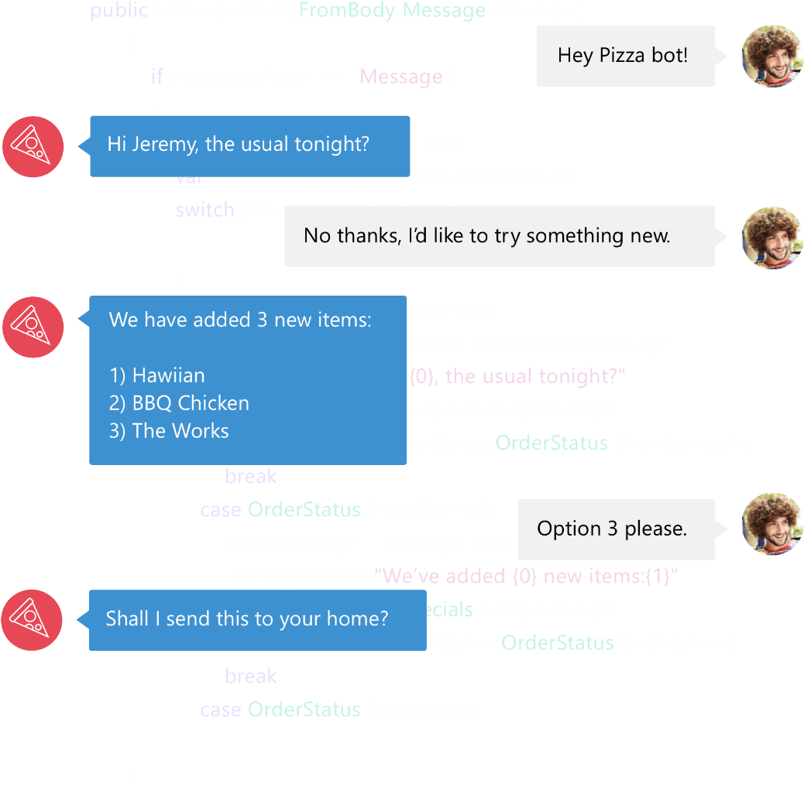

Bot Framework
Bot Framework is a Microsoft-operated service and an SDK.
Bot Framework is one of many tools Microsoft offers for building a complete bot.
Others include: LUIS, Speech APIs, Azure, more
www.botframework.com

Slide 4
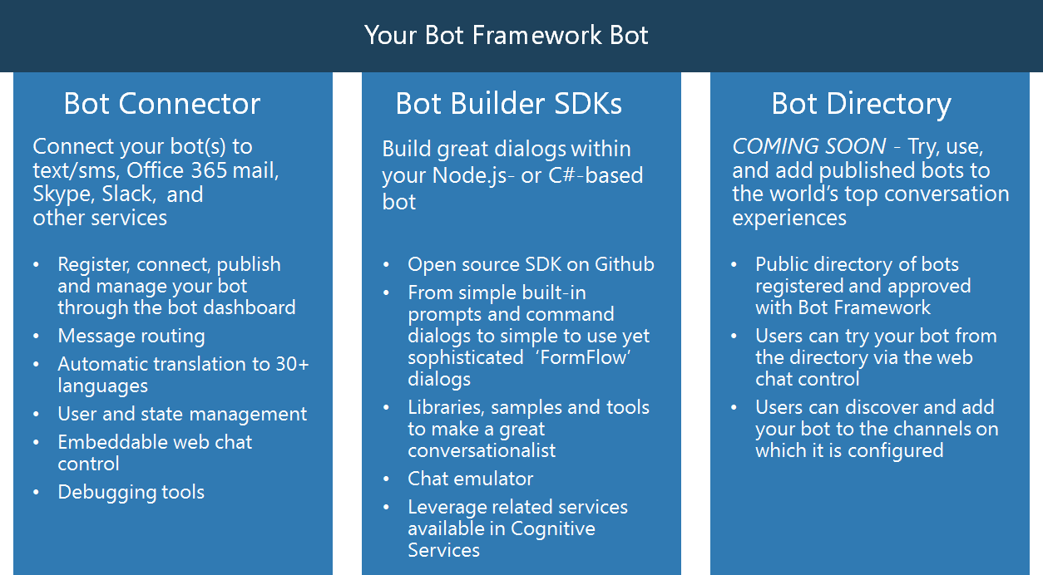

Slide 5
Your bot
Logic
Your conversation logic
Bot Builder SDK (Node.js + C#)
Web service
LUIS

Slide 6
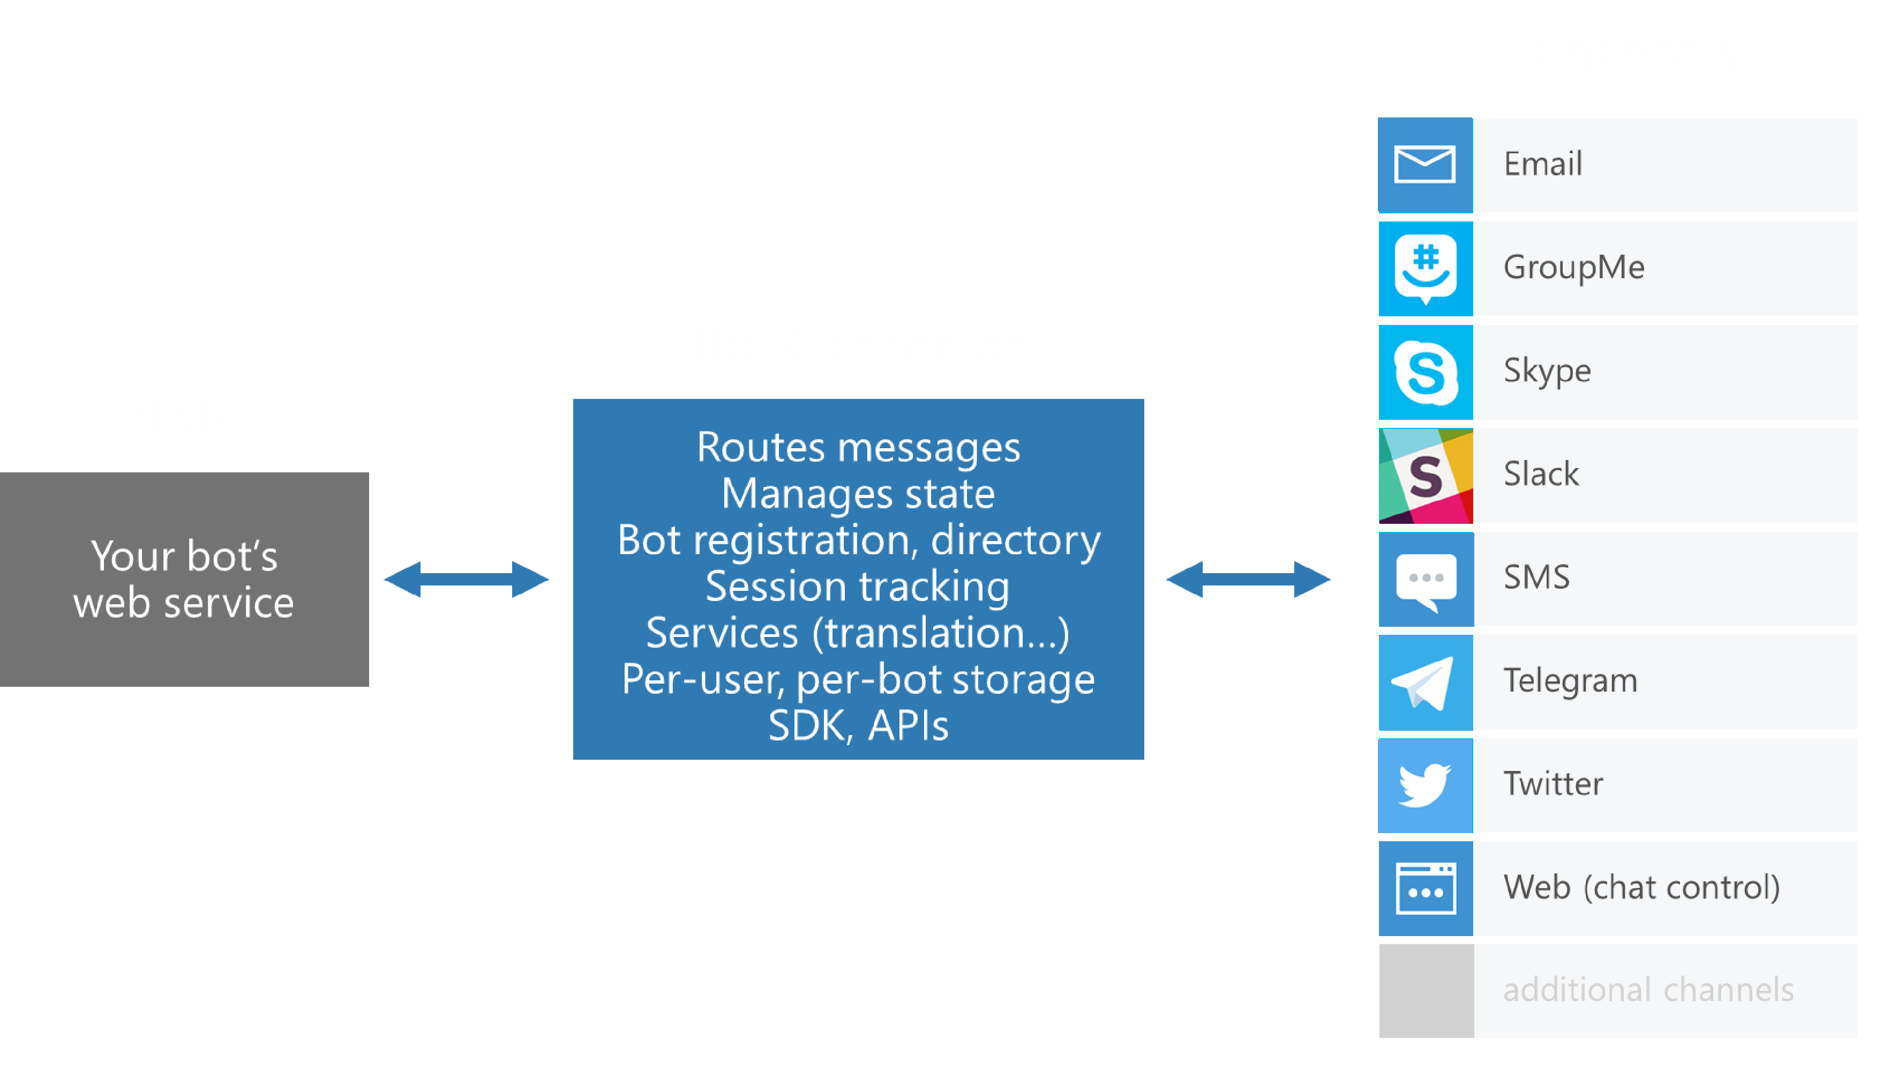
Bot Connector
Dev portal
Bot Connector
Send/receive messages
Store state
Translation
Telemetry
…
Your bot

Slide 7
Bot Connector messages
Your bot
Bot Connector
{
"type": "Message",
"id": "68YrxgtB53Y",
"conversationId": "DphPaFQrDuZDKyCez4AFGcT4vy5aQDje1lLGIjB8v18MFtb",
"language": "en",
"text": "You can say \"/order\" to order!",
"attachments": [ ],
"from": {
"name": "+12065551212",
"channelId": "sms",
"address": "+12065551212",
"id": "Ro52hKN287",
"isBot": false
},
"channelData": { SMS data here },
"botUserData": { your data here },
...
}

Slide 8
Visual Studio Template
Simple Stock Bot
LUIS
Publish to Azure
Add dialog smarts
Connect to users

Slide 9
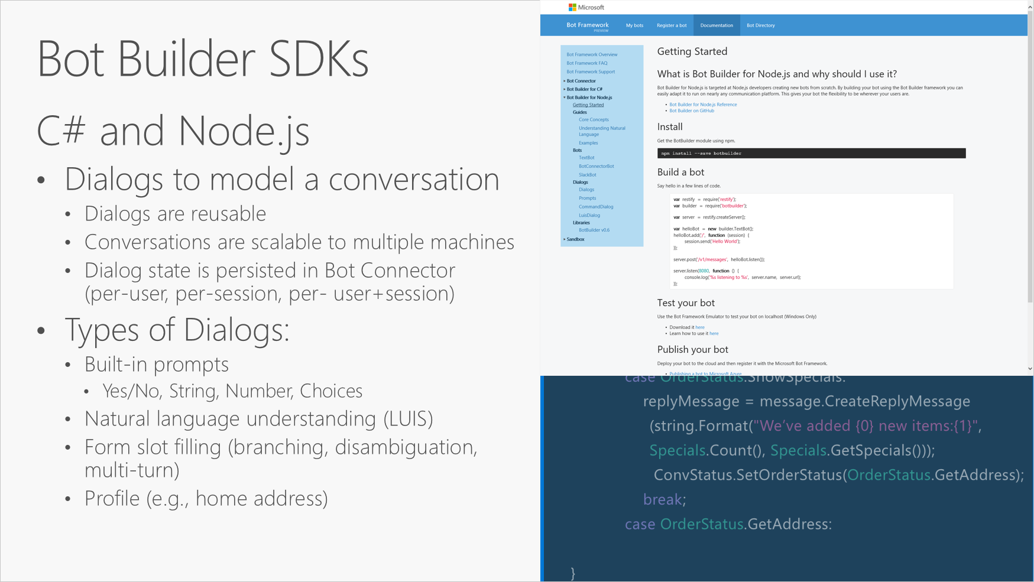

Slide 10
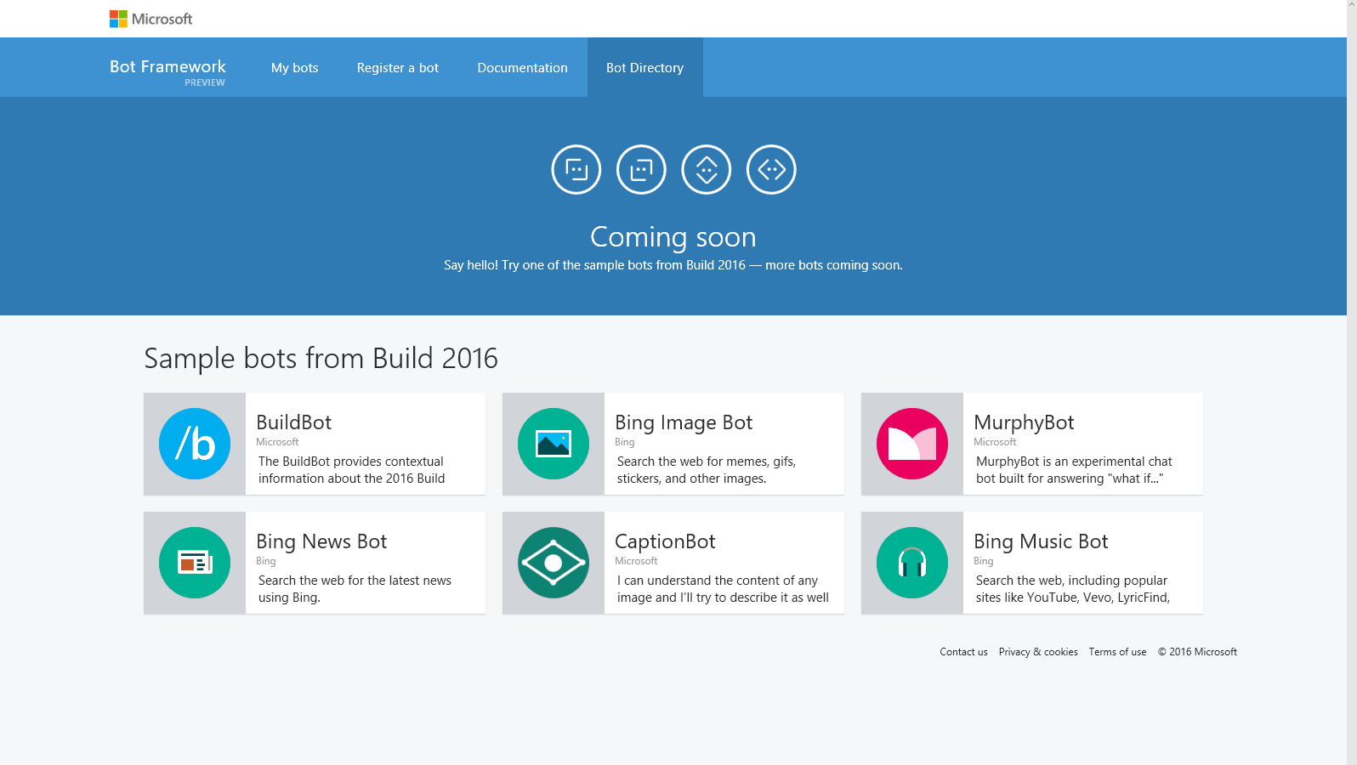

Slide 11
File -> New bot
Visual Studio Template
Simple Stock Bot
LUIS
Publish to Azure
Add dialog smarts
Connect to users

Slide 12
Connecting your bot to users
Visual Studio Template
Simple Stock Bot
LUIS
Publish to Azure
Add dialog smarts
Connect to users

Slide 13
Dialog smarts
Visual Studio Template
Simple Stock Bot
LUIS
Publish to Azure
Add dialog smarts
Connect to users

Slide 14
Resources
botframework.com
www.botframework.com

Slide 15
Thank You!

